Slide 1
Employee Attrition Analysis
Name : M Janaki Ramudu

Slide 2
Introduction
Employee attrition, or turnover, is the loss of employees from a company.
High attrition rates can be costly for businesses, impacting productivity, morale, and customer service.
This analysis aims to identify factors contributing to employee attrition within our company

Slide 3
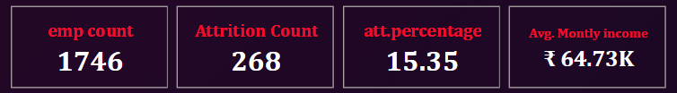
Data Overview
Dataset Summary:
Total Employees: 4346
Attrition Count: 701 (16.13%)
Average Monthly Income: ₹65.08K

Slide 4
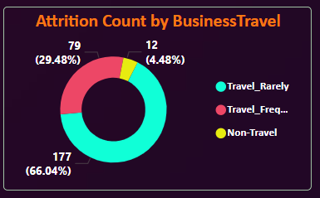
Attrition by Business Travel
Majority travel rarely (65.91% attrition rate).
Frequent travel has the lowest attrition (5.14%).

Slide 5
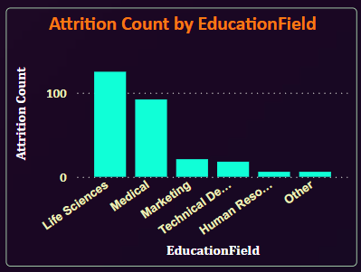
Attrition by Education Field
High attrition in Life Sciences and Medical fields.
Technical and HR fields show lower attrition.

Slide 6
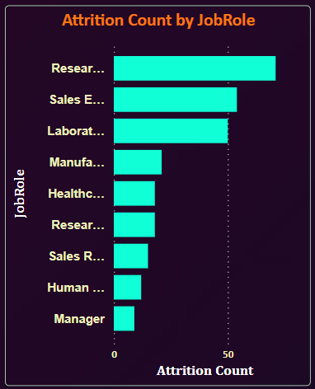
Attrition by Job Role
Sales Executives and Research Scientists have the highest attrition.
Lower attrition observed in Human Resources and Sales Representatives.

Slide 7
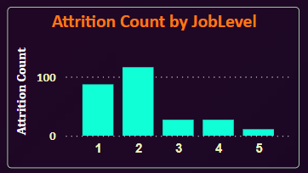
Attrition by Job Level
Highest attrition in Job Level 1.
Attrition decreases significantly at higher job levels.

Slide 8
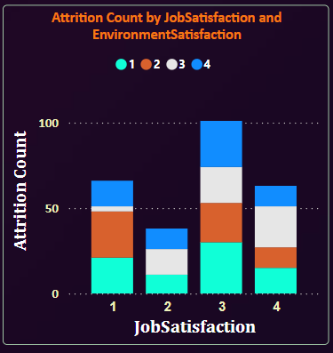
Job Satisfaction and Environment Satisfaction
Mixed levels of satisfaction affecting attrition, with lower satisfaction correlating with higher attrition.

Slide 9
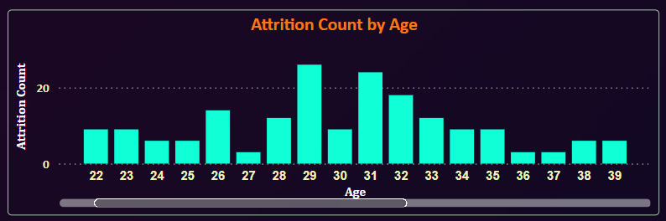
Attrition by Age
Peak attrition in the late 20s to early 30s.
Attrition stabilizes in later age groups.

Slide 10
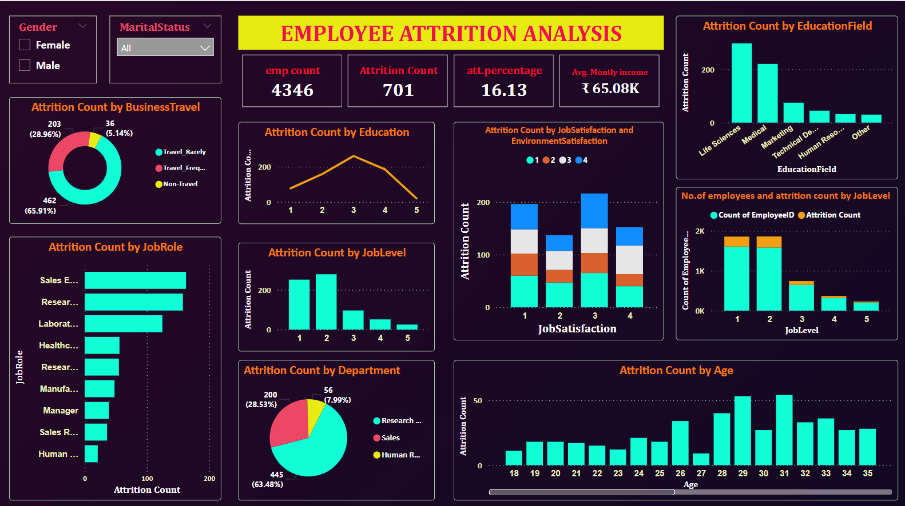

Slide 11
Key Insights
High Attrition in Sales and Research Departments: Sales Executives and Research Scientists show the highest turnover.
Impact of Business Travel: Employees who travel rarely have the highest attrition rates.
Mid-Level Career Stagnation: Employees in mid-level job roles and educational backgrounds show elevated attrition, indicating potential satisfaction issues.
Age Factor: Attrition peaks among employees aged 28-31, possibly due to career transitions.
File link: https://drive.google.com/file/d/1cuyI2TIPzxtnhkOXZ1iPdm3S-oSx6IIe/view?usp=sharing

Slide 12
Thankyou

